Slide 1
Potentiostat GUI: Project description and deliverables

Slide 2
General themes
Examples of UIs we like:
Wix.com website builder
Spotify
Microsoft office products
Generally, stick with light/white color themes
We can describe in detail what we like about these various UIs by phone w/ candidates at a later date

Slide 3
General home screen layout
Sidebar, with options to open other tabs
Main window, with the primary “run an experiment” tab open by default
Cockpit mode
Experiment-builder
Open data file
Chronoamperometry/coulometry
Chronopotentiometry
Linear sweep voltammetry
Cyclic voltammetry
Cyclic voltammetry (advanced)
Pulse voltammetry
Staircase voltammetry
Electrochemical impedance spectroscopy, potentiostatic
Electrochemical impedance spectroscopy, galvanostatic
Electrochemical impedance spectroscopty, pseudo-galvanostatic
Cyclic voltammetry is the combination of a forward sweep and a reverse sweep.
Starting voltage: _______
Vertex 1: ________
Vertex 2: ________
Scan rate: ________
# repetitions: ________
|Start|
List of electrochemical “techniques”
This pane would list the parameters for the highlighted experiment, as well as a brief description
We will provide the list of techniques and accompanying parameters.

Slide 4
General home screen layout
Some of our units will have multiple independent channels, and so organizing and separating the controls for each channel is important, as is minimizing clutter
To address this, we would like the main screen to have tabs, one main tab as shown in the previous slide
Other tabs will open when experiments start, with corresponding graphs, controls to pause or stop the experiment, experimental progress, and real-time values

Slide 5
Behind the scenes
Each electrochemical technique (except for impedance spectroscopy) is basically just a collection of voltage steps and linear voltage sweeps.
For each experiment, the GUI will break down the technique into single steps/nodes and send those steps to the MCU via serial-over-USB. If the MCU does not have enough memory to buffer all of the steps, the GUI will have to schedule additional data transfers as the experiment progresses.
In order to minimize the need for future firmware updates, the GUI will do most of the decision-making about data sampling rates and other timing issues.
An example packet would include:
Step number
Cycle number
Step starting voltage or current
Ending conditions, max and min step duration
Scan rate, DAC update rate
Sampling rate, sampling delay w.r.t. DAC update event

Slide 6
Behind the scenes
For electrochemical impedance experiments, it’s a little more complicated. Each experiment is made up of scans at specific frequencies, adding up to a frequency sweep.
The GUI breaks down each experiment into steps and transfers the step parameters to the MCU:
Frequency
Channel mode
DC bias
Sampling rate
Gain
…
As data comes in, the software must perform some simple analysis:
Check if the data is clipping, or if there is too much DC drift, and if so, tell the MCU to repeat the measurement
Perform a FFT and display the results in the real-time values location

Slide 7
Graphing
Graph should automatically open as a new tab upon the start of the experiment. Each type of experiment will have its own “preferred” variables plotted on the x- and y-axis.
Graph should automatically open once the experiment starts
Users should be able to overlay old data onto graphs to compare experimental results
Pan, zoom, ability to customize axes, line and dot colors
Hover-over points to see values

Slide 8
“Cockpit” view
In the next slide is a screenshot of our current software. It allows more “real-time” control of our instrument, as opposed to pre-built experiments. This method of control will be relegated to a special section called “Manual operation” or “Cockpit view.”
Almost everything in our old software will need to be transferred to a better-looking version

Slide 9
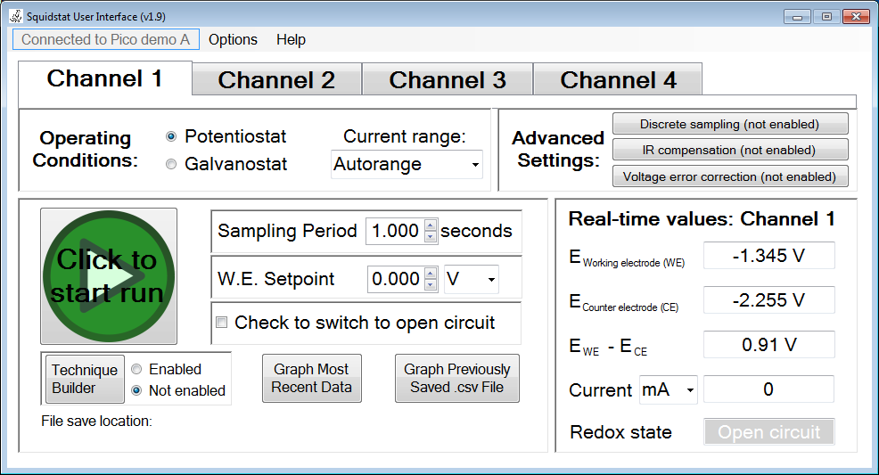
“Cockpit” view

Slide 10
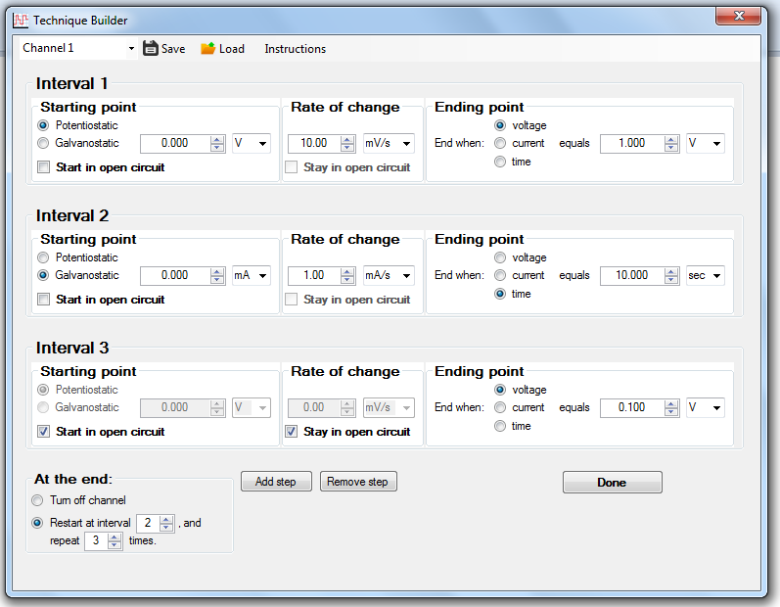
Technique Builder
Our “technique builder” enabled the user to build up experiments consisting of combinations of steps and linear sweeps. We want to keep this ability, but make it drag-and-drop. This is because our current layout can be intimidating and unclear to first-time users.
We need to keep the flexibility of this window, and the ability to fine tune each of these parameters, but make it much easier to use.
I envision a palette of building blocks that the user can drag and drop into a workspace. The user can build up linear sequences of steps and sweeps, but can also loop through segments. The list and functionality of each building block will be provided by us.

Slide 11
Competitor software
The next few slides show examples of competitors’ GUIs, along with some comments about what we do and don’t like about them

Slide 12
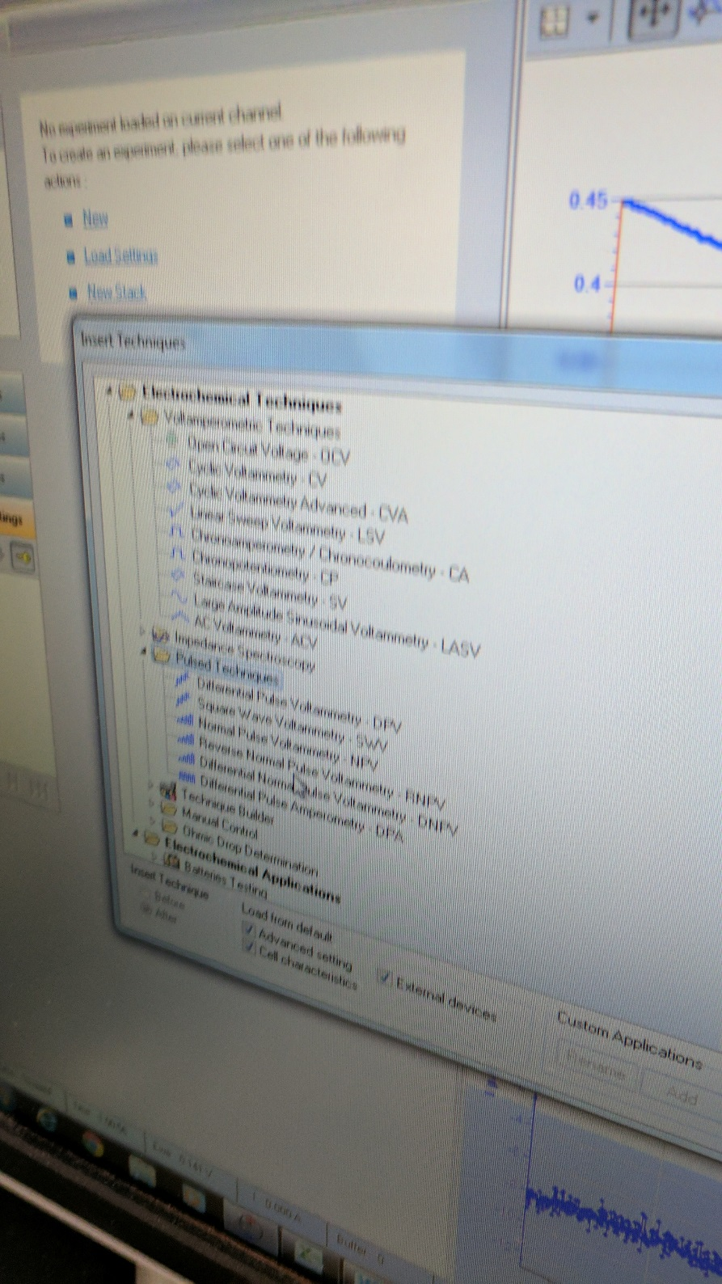
Here the software lists pre-built experiments. The folder system organizes the experiments, and a small icon next to each experiment shows a rough sketch of what the experimental waveform looks like
What we like
Well organized branched menus categorizing the different types of experiments
What we don’t like
Takes an extra click to get to the list of experiments. We want this list to be open as part of the main screen.
What we want ours to be like:
Organize and group experiments by waveform type, but also by application type & field of study

Slide 13
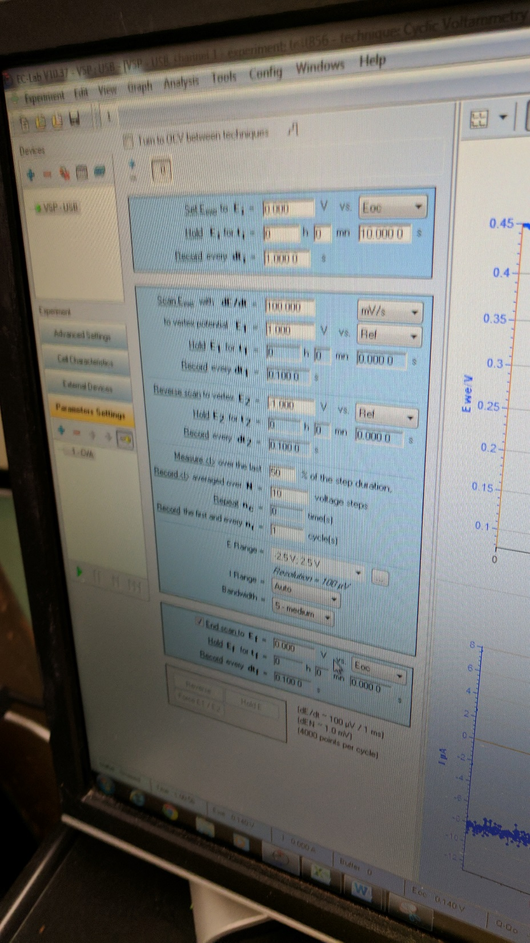
In the center is shown a list of experimental parameters for one of the prebuilt experiment types, and text boxes for users to fill in.
What we like
On the left there is a pane for a list of experiments that can be chained together and performed sequentially.
What we don’t like
It’s thorough, but possibly too crowded and confusing.
To the right, you can see a part of the experimental results being graphed.
What we want ours to be like:
Hover-over text for each parameter to explain what it means
This list of parameters should be shown on the same screen as the list of experiments to pick from, and the graphing window should pop up after the experiment begins

Slide 14
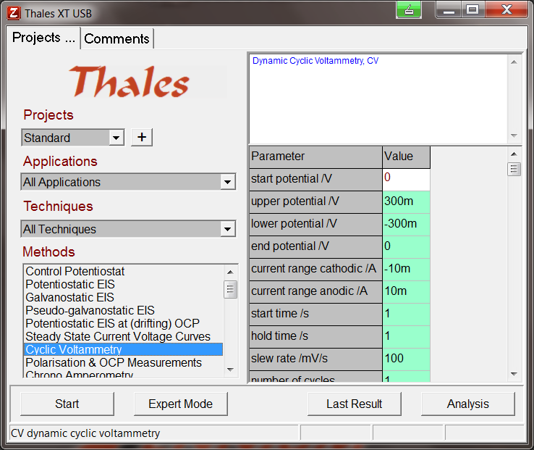
This is from our sister company. This starting pane is sort of what we’re going for with our main screen layout, but we want ours to be much more modern-looking.
What we like
The experimental methods is on the left, and the specific parameters to fill in is on the right
What we don’t like
Looks really old
What we want ours to be like:
Similar format, but modern

Slide 15
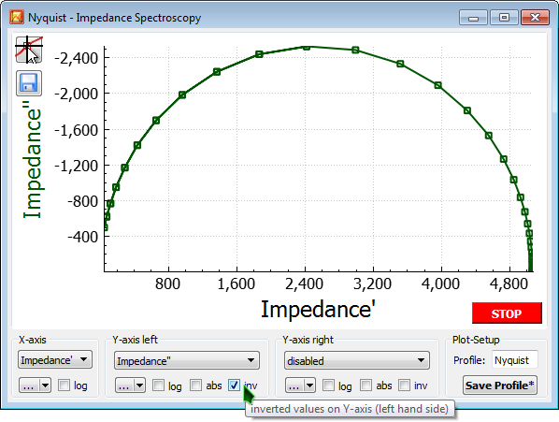
An example of the graphing/control window that pops up when you start an experiment. It has the ability to easily change the variables plotted on each axis, as well as log/linear scale selections, and the ability to save the plot. We like all of these things and want our graphing window to look similar to this, except we want the menu options on the bottom to instead be on the left side

Slide 16
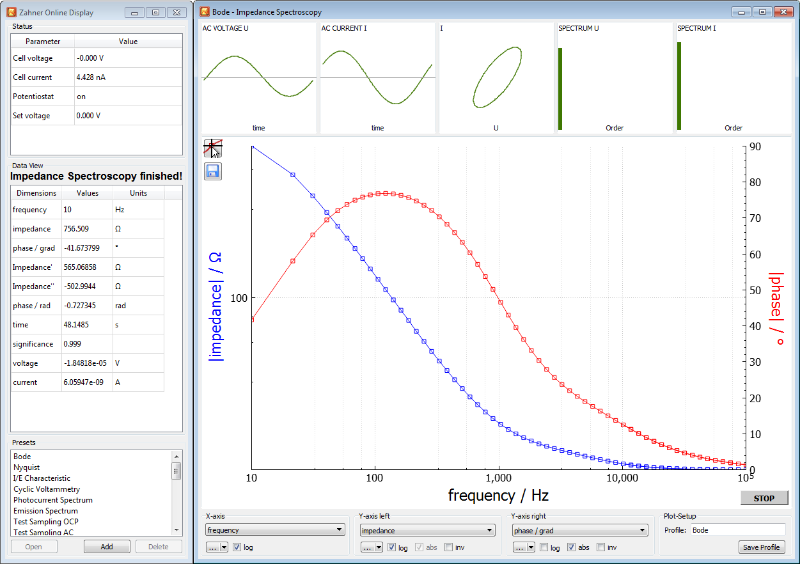
Another real-time data plot with a few controls at the bottom. We like the combination of the real-time values/controls and graphing window side-by-side. The stop button should be more prominent, though.

Slide 17
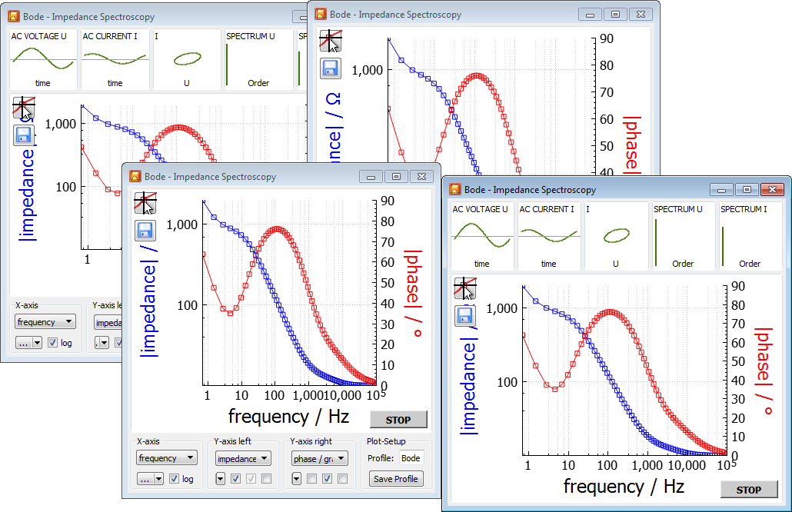
The user will want the ability to see multiple graphs simultaneously. This can get crowded, though, so the option of grabbing windows and turning them into tabs might help here.

Slide 18
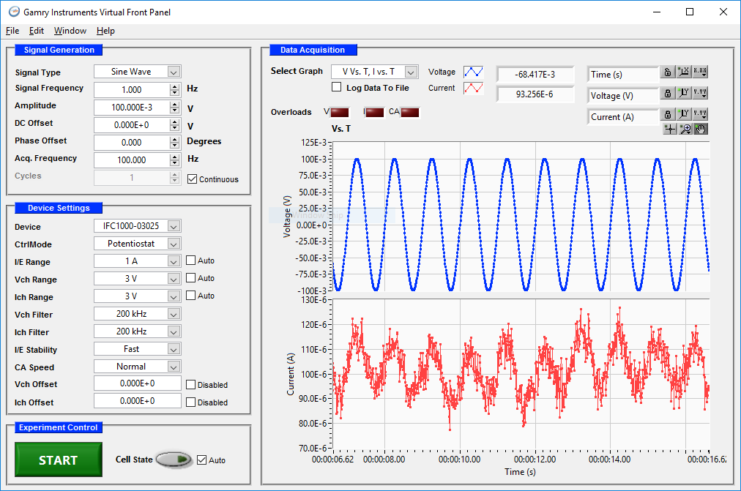
What I don’t like about this software is the small, text-less icons in the upper right. We want to stay away from having any icons be standalone without text or a popup of words when a mouse goes over it, like in Wix Functionally, this is not too different from our current cockpit mode. It looks slightly dated, and a bit crowded. The blue labels look “cheap.” The “start” button could be more prominent. Overall, it’s not too bad, though. It’s like MS Word 2007, while we’re going for MS Word 2016.

Slide 19
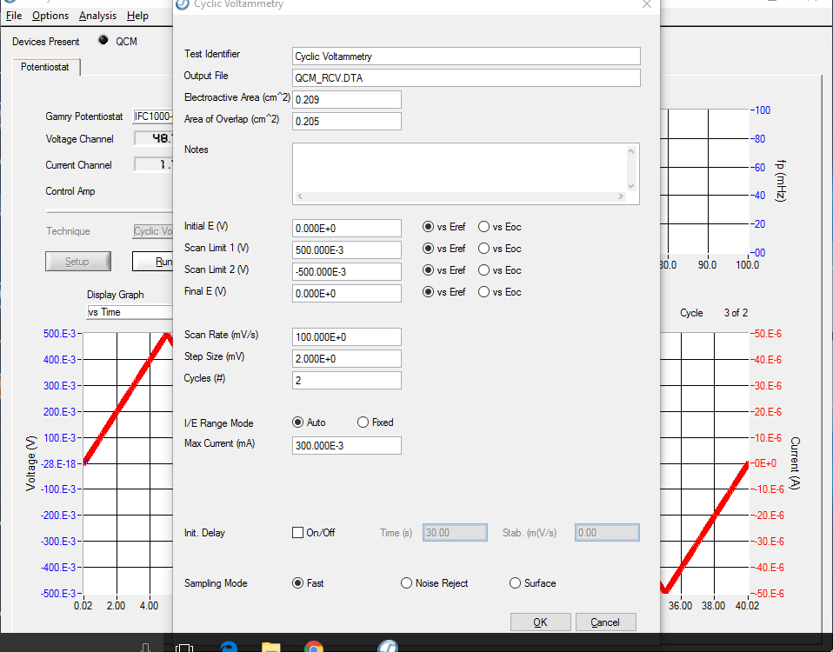
Here’s an example of an experiment setup screen. Some of the fields are not well-explained, and could use some sort of help function or hover-over text.

Slide 20
Milestones
Milestone 1/Trial period: Design the look/feel of the cockpit mode
Milestone 2: Design the look/feel of the rest of the pages/windows
Home screen, primary control tab/experiments list
Drag-and-drop technique builder
Tab with experiment data plot + channel controls
Cockpit mode
Milestone 3: create framework for building experiments
You will use this framework in future milestones to put together the list of pre-built experiments on the main page. We will need to use it in the future to easily add new experiments to the list.
The framework will break down the experiments into basic steps/nodes, as described on slide 5.
Milestone 4: implement cockpit mode
By the end of this step, we should be able to manually control every feature of the hardware.
Milestone 5: implement the guts of the technique builder, using the framework created in Milestone 3
By the end of this step, we should be able to drag and drop blocks to make an experiment, while the software builds up a collection of nodes in the background
Users should be able to save and load these custom experiments

Slide 21
Milestones
Milestone 6: Work with the MCU programmer (me) to set up a communication protocol between the software and the MCU
By the end of this step, we should be able to use the technique builder to run experiments with the hardware prototype
Milestone 7: Populate the list of pre-built experiments and all of their user-input parameters
By the end of this step, we should be able to run all pre-built experiments with the hardware prototype
This milestone is more flexible. If it ends up requiring too much electrochemistry background knowledge, then I may complete this milestone myself.
Milestone 8: Implement the graphing and experiment control pane for DC experiments
The software should be able to parse incoming data and graph it
Milestone 9: Implement the graphing and experiment control pane for AC experiments
See slide 6 for a description

